Slide 1

NATURAL GAS PRICE PREDICTION

Slide 2




OUR TEAM

Slide 3
INTRODUCTION
We will develop a supervised Machine Learning algorithm to predict PADD Natural Gas Prices.
We want to understand the drivers of Natural Gas prices in North America.

Slide 4
DATA
DATASETS
The data was gathered from the EIA, Energy Information Administration, CME Group and CFTC, Commodity Futures and Trading Commission. The top 3 three features are Spot Price, Sit, in each Node, Henry Hub Spot Price, HHst, and the Transportation Cost, Basis, HHDiffit.
DATA CLEANING
The data cleaning process was completed in Jupyter notebook. The dataset gathered from the EIA, CME Group and CFTC were combined by matching Dates. The columns gathered are HHst, Sit, Ft, COT, INV, DNG, and QNG. 7 Variables were created exclusively in Jupyter., HHDiffit, Returns, Volatility, cott, iCot, iDNG and DNGit.

Slide 5
HYPOTHESIS
The hypothesis is to predict the Spot price of each node with the risk metrics Traders use to understand the market. A mix of Supply and Demand factors both physical and financial were used to our EDA and prediction models.

Slide 6
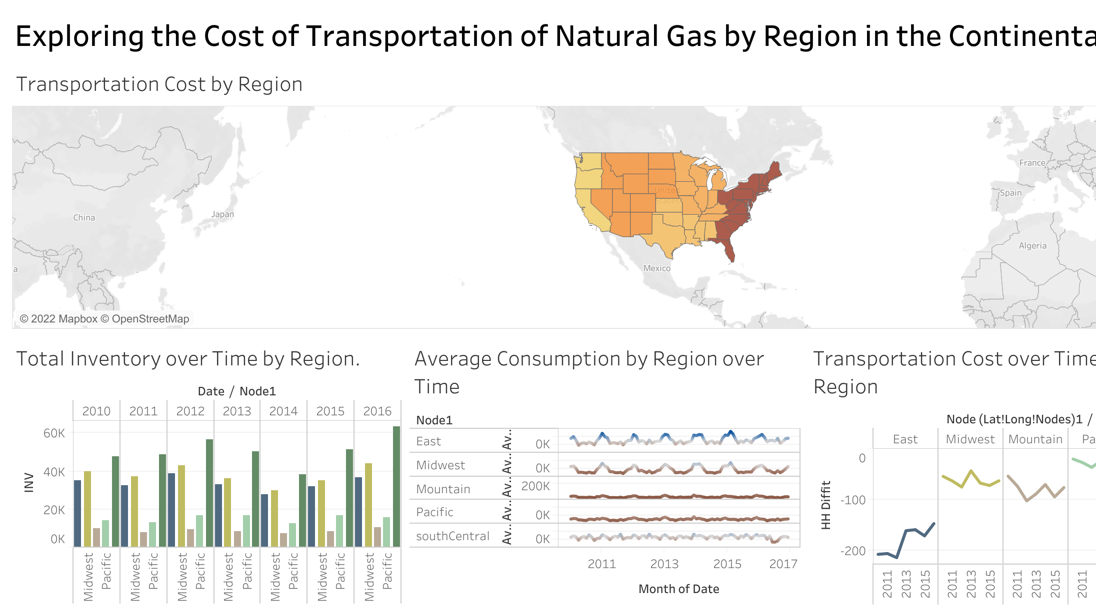
VISUALIZATION

Slide 7
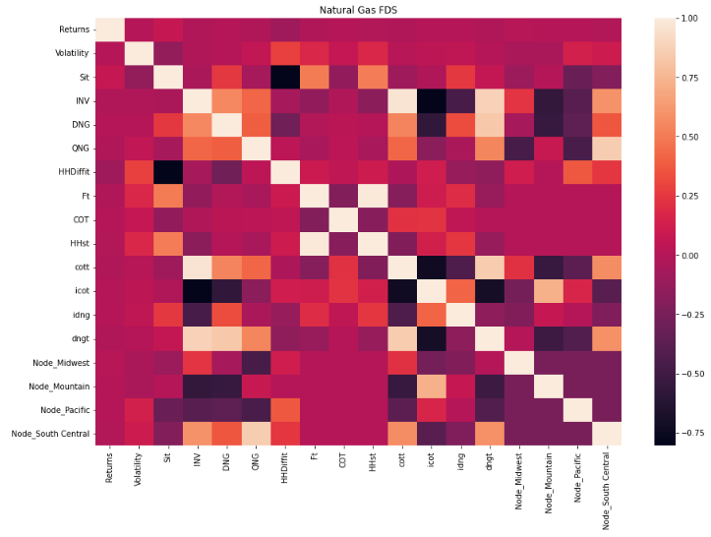
MACHINE LEARNING

Slide 8
LIMITATIONS
Our initial limitation is tree based model while efficient in making predictions are not easily explainable.
We chose to use a Linear Regression as these are easier explain and are used more frequently by practicing Traders, Risk Managers and Quants.
Weather was not included in the variables for this model.

Slide 9
CONCLUSIONS
Tree based models while useful for predictions outside of Natural Resource Markets, they are limited in the “Explainability” factor within Natural Resource Markets. Tree Based models add more complexity to an already complex market. Stakeholders make it a requirement that Quants, Traders, and Risk Managers explain the what is causing such large capital deployments. Stakeholder think in terms of ROI/PnL, and to justify large amounts of capital to be deployed on moments notice a Linear Regression Models does the job of showing this justification.

Slide 10
QUESTIONS

